Slide 1
Employee Data Analysis using Excel
STUDENT NAME : VAISHNAVI.K
REGISTER NO : 312216816(asum1659312216816)
DEPARTMENT : B.COM(ACCOUNTING&FINANCE)
COLLEGE : SHRI KRISHNASWAMY COLLEGE FOR WOMEN

Slide 2
PROJECT TITLE
Employee Performance Analysis using Excel

Slide 3


AGENDA
Problem Statement
Project Overview
End Users
Our Solution and Proposition
Dataset Description
Modelling Approach
Results and Discussion
Conclusion
3/21/2024 Annual Review

Slide 4

PROBLEM STATEMENT .Employee Demographics .Departmental Analysis .Salary And Compensation .Employee satisfaction .Attendance and leave analysis .Promotion and growth .Training and development .Diversity and Inclusion .

Slide 5

PROJECT OVERVIEW
The aim of to analyze employee data to uncover trends, patterns and insights that can help improve organizational efficiency,employee satisfaction and overall performance.
The analysis will be conducted using Microsoft excel.

Slide 6

WHO ARE THE END USERS? 1.Human Resources Managers(HR) 2.Team Leads & Dep. Managers 3.Executives & Senior Managers 4.Data Analysts 5.Consultants 6.Operations & Project Managers 7.Compensations & Benefits Team 8.Talent Development Teams 9.Employee themselves

Slide 7

OUR SOLUTION AND ITS VALUE PROPOSITION 1.Data Consolidation and management 2.Trend Analysis and forcasting 3.Employee Segmentation 4.Perfomance Reporting 5.Cost-Effective Tool 6.Flexibility and customization 7.Scalability 8.Improvement in performance 9.Empowerment of Decision-making

Slide 8
Dataset Description This dataset description provides a comprehensive understanding of the structure,content and context of the employee performance analysis dataset,making it easier for stakeholders to understand and use the data effectively.

Slide 9
THE "WOW" IN OUR SOLUTION *Real-Time Interactive Dashboards *Predictive Analytics Integration *Automated Performance Reports *Customizable Employee Scorecards *Seamless Data Integration *Advanced Data Visualization Techniques *Gamification Elements *Scenario Analysis & What-If Modeling *Integration with Microsoft 365 Tools *Employee Self-Serivce Portal
9

Slide 10
MODELLING
Data Collection and Preparation
Perfomance Scoring Model
Predictive Turnover Model
Employee Segmentation Model
Time Series Forcasting Model
Resources Allocation Model
Scenario Analysis and What-If Modeling
10

Slide 11
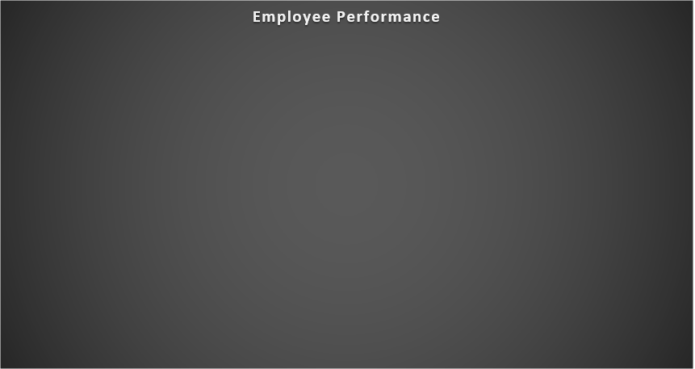
RESULTS
11

Slide 12
conclusion
Excel remains a versatile and accessible tool for employee performance analysis, especially for organizations seeking a cost-effective solution that doesn’t required complex software. While it may have limitations compared to specialized HR analytics platforms, its wide range of funcationalities, ease of use, and ablity to handle large datasets,make it an invaluable resources for HR professionals and managers. By effectively utilizing Excel, organizations can not only monitor and evaluate employee performance but also drive strageric decisions that contribute to overall business success. Employee performance analysis using excel is a powerful approach that provides organizations with actionable insights to enhance their workforce management strategies.

Slide 13
conclusion
Excel remains a versatile and accessible tool for employee performance analysis, especially for organizations seeking a cost-effective solution that doesn’t required complex software. While it may have limitations compared to specialized HR analytics platforms, its wide range of funcationalities, ease of use, and ablity to handle large datasets,make it an invaluable resources for HR professionals and managers. By effectively utilizing Excel, organizations can not only monitor and evaluate employee performance but also drive strageric decisions that contribute to overall business success. Employee performance analysis using excel is a powerful approach that provides organizations with actionable insights to enhance their workforce management strategies.

Slide 14
conclusion
Excel remains a versatile and accessible tool for employee performance analysis, especially for organizations seeking a cost-effective solution that doesn’t required complex software. While it may have limitations compared to specialized HR analytics platforms, its wide range of funcationalities, ease of use, and ablity to handle large datasets,make it an invaluable resources for HR professionals and managers. By effectively utilizing Excel, organizations can not only monitor and evaluate employee performance but also drive strageric decisions that contribute to overall business success. Employee performance analysis using excel is a powerful approach that provides organizations with actionable insights to enhance their workforce management strategies.

